Slide 1
Photo Album
Completed Projects
by PatrickMcAllister
President, Corporate Engineering

Slide 2
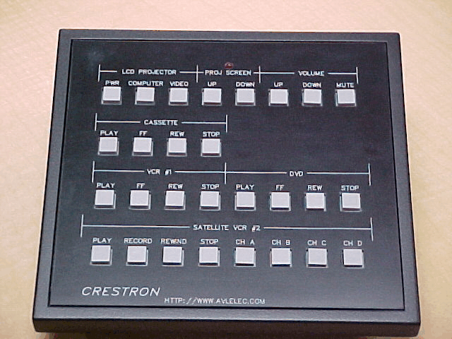
Notes:
Programmable Wireless Control Panel

Slide 3
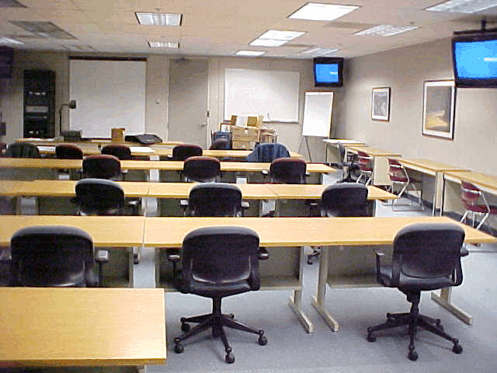
Notes:
Abbott Laboratories Training Center

Slide 4
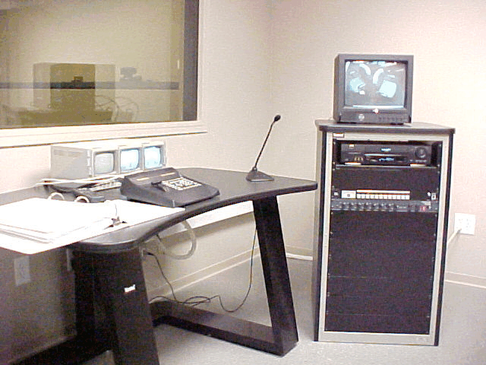
Notes:
Motorola Usability Laboratory

Slide 5
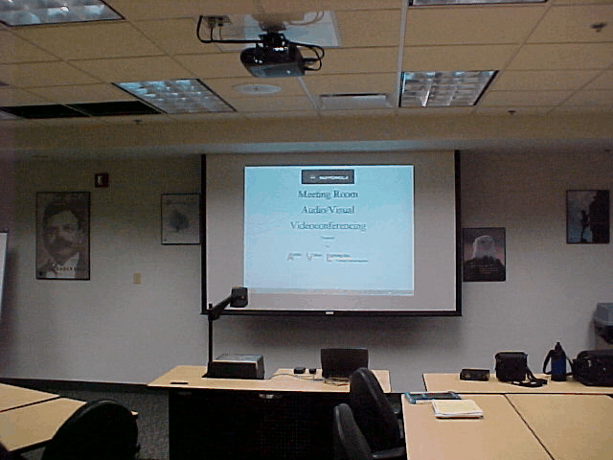
Notes:
Motorola Meeting Room for Videoconferencing

Slide 6
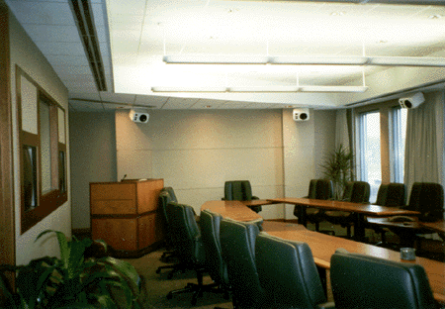
Notes:
Moore Business Forms Corporate Presentation Facility

Slide 7
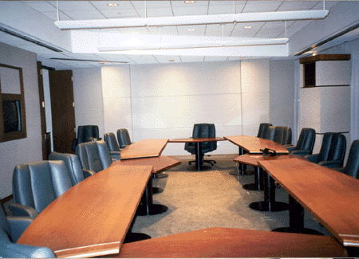
Notes:
Santa Fe Railroad Teleconferencing Room

Slide 8
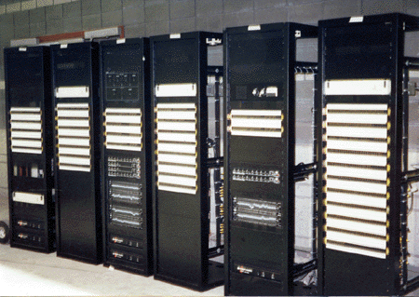
Notes:
57 Equipment Racks for McCormick Place

Slide 9
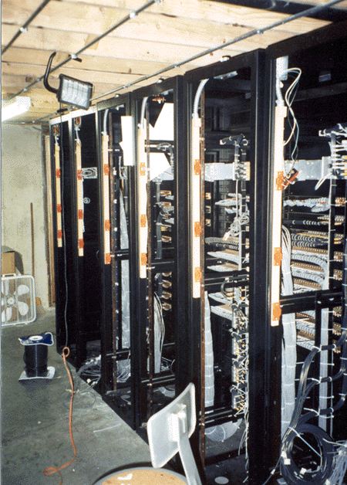
Notes:
Fabrication Process

Slide 10
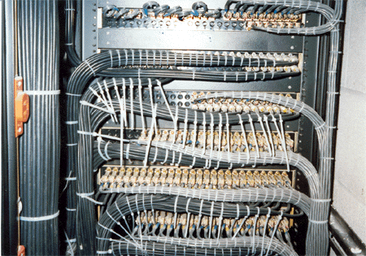
Notes:
Harnessing Process

Slide 11
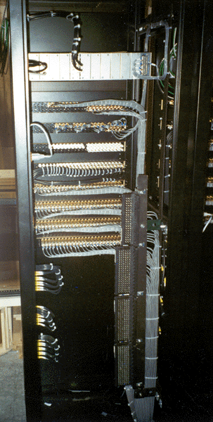
Notes:
Completed Wiring

Slide 12
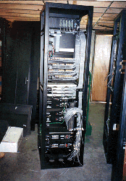

Slide 13
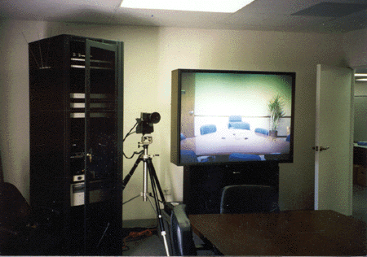

Slide 14
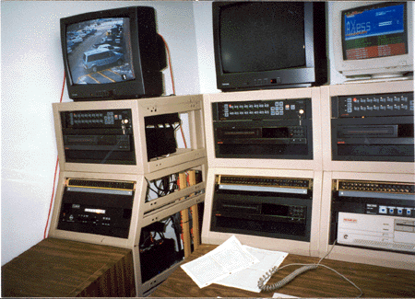

Slide 15
